Slide 1

Hostinger
We are what we value @Vinted Tech Lead Meetup

Slide 2
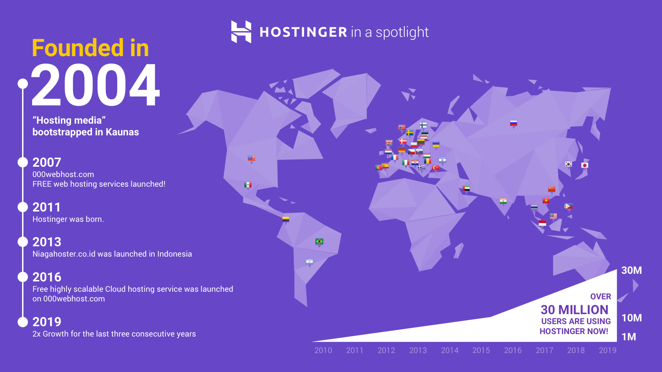

Slide 3
Mission
Help website developers and their customers succeed and grow online
Notes:
Create the biggest web hosting provider accessible to everyone (and make money on the way)

Slide 4

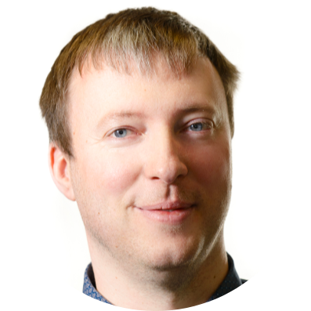
“One of the most important things to me is that your contribution can impact millions of people worldwide”
Skirmantas Juraška
DevOps Engineer

Slide 5
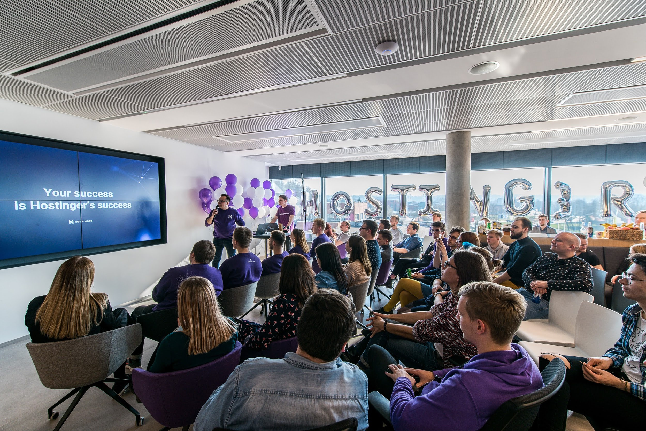
Notes:
Monthly newbie sessions to introduce our values and mission

Slide 6
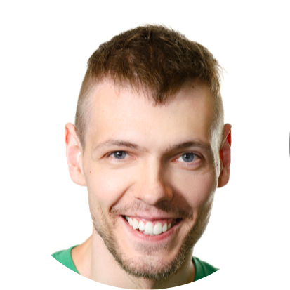
“Over-engineering is the lack of fundamentals. In Hostinger, we have a standard to keep learning how things work instead of doing stuff”
Donatas Abraitis
DevOps Engineer

Slide 7
Hostinger culture flows from our core Principles

Slide 8
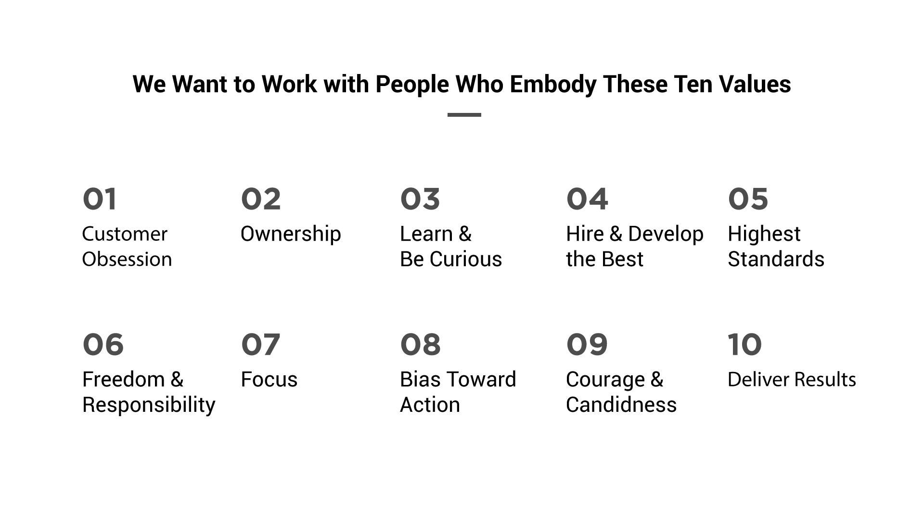
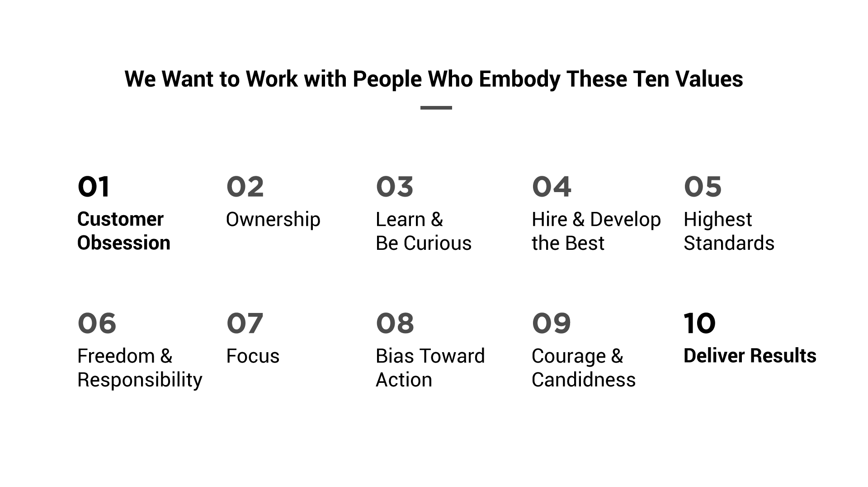
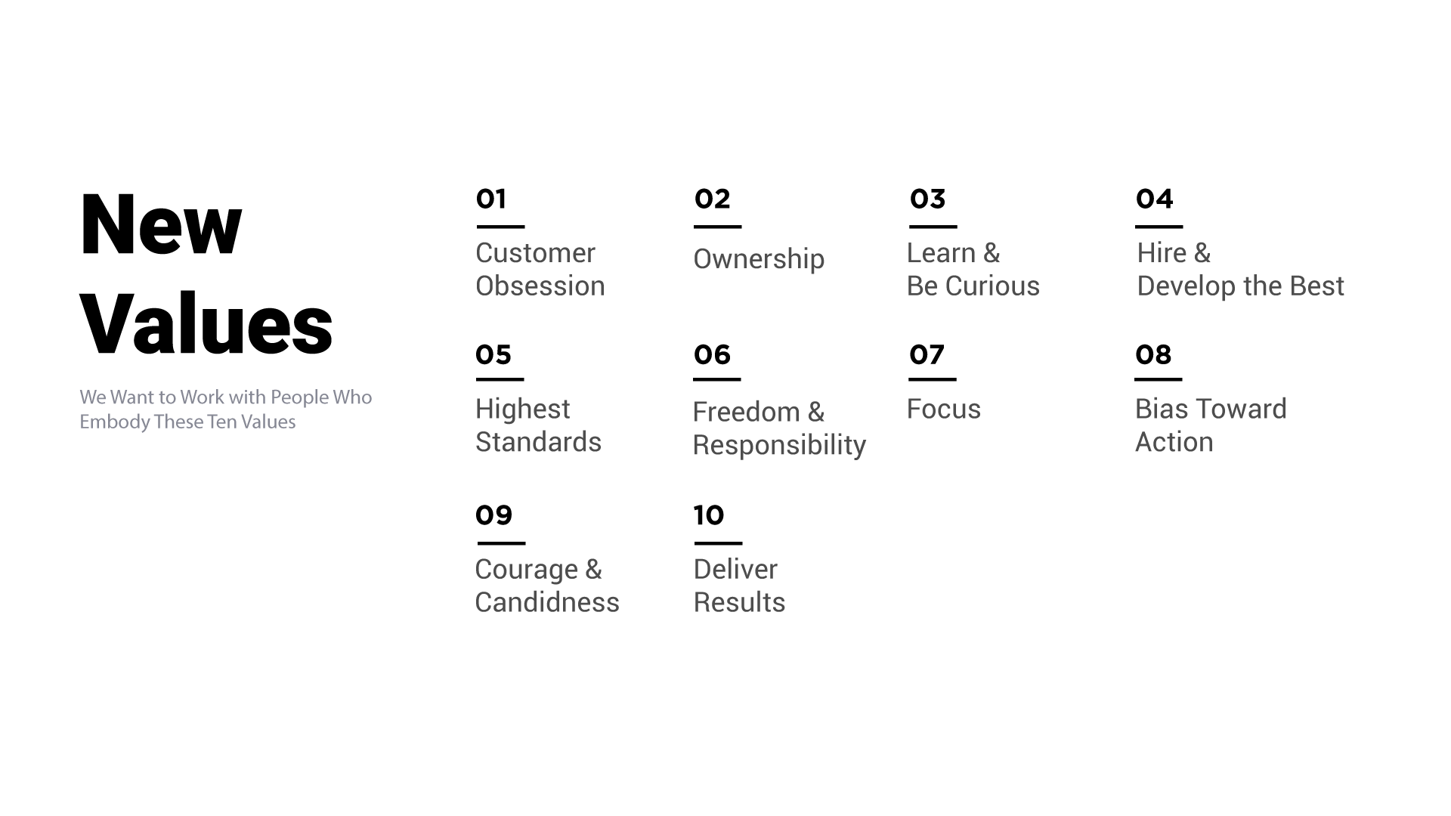
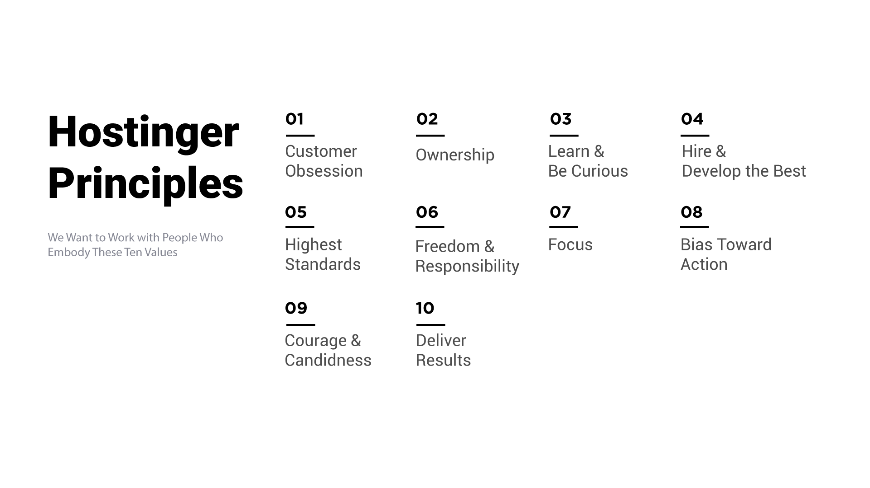
We Want to Work with People Who Embody These Ten Values
Customer Obsession
Ownership
Learn & Be Curious
Hire & Develop
the Best
Highest Standards
Freedom
&
Responsibility
Focus
Bias Toward Action
Courage
&
Candidness
Deliver Results
Notes:
Žalia

Slide 9
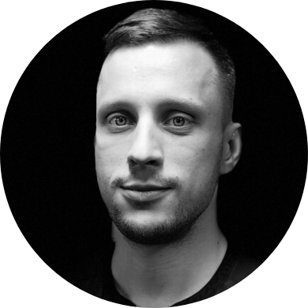
“Consistently delivering meaningful results is a team sport: guide, engage and recognize others as much as you push yourself”
Balys Krikščiūnas
CEO

Slide 10
We follow our principles to decide
who gets rewarded, promoted or let go
Notes:
We challenge directly and care personally.
We do not compromise for the sake of pseudo harmony in the team.

Slide 11

“Company culture’s secret ingredient - People. Hire individuality with a great talent and a passion to change the world”
Gabija Jasiulionyte
Head of People

Slide 12
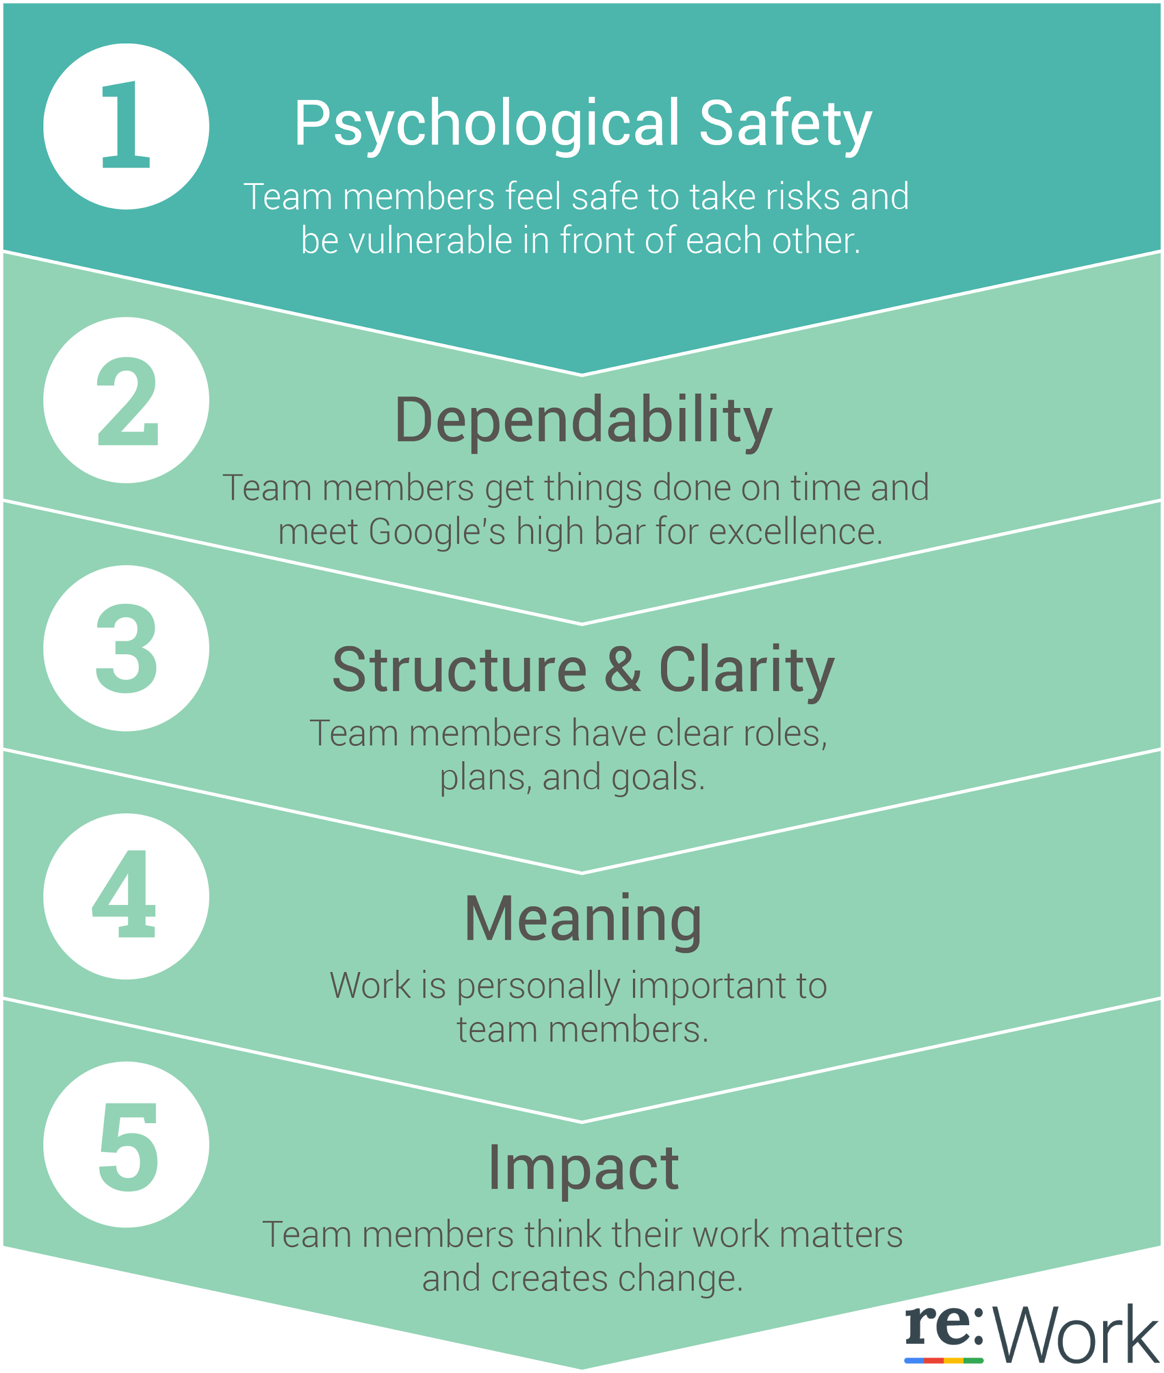
5 Key Dynamics for a successful Team @Hostinger
Notes:
We challenge directly and care personally.
We do not compromise for the sake of pseudo harmony in the team.

Slide 13
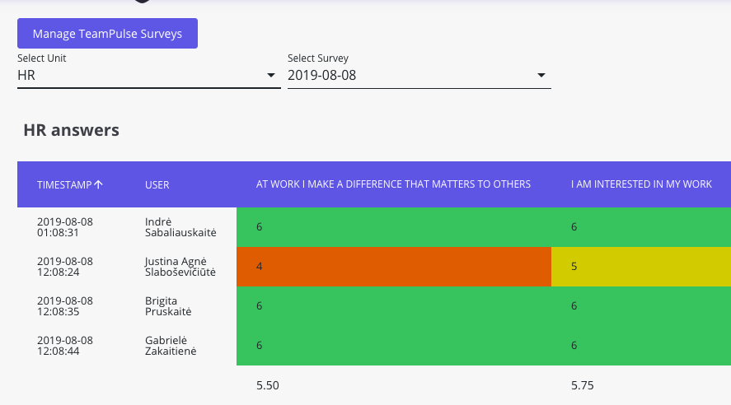
Notes:
We challenge directly and care personally.
We do not compromise for the sake of pseudo harmony in the team.

Slide 14
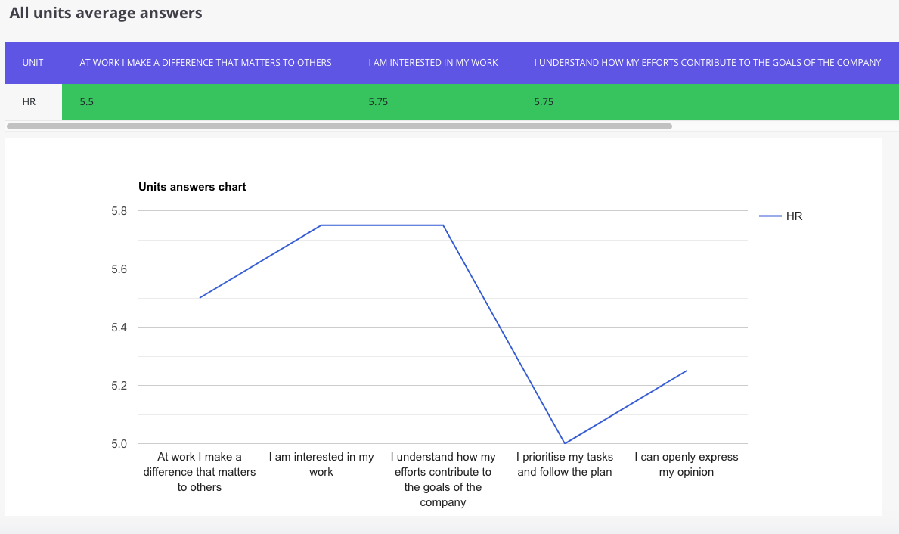
Notes:
We challenge directly and care personally.
We do not compromise for the sake of pseudo harmony in the team.

Slide 15
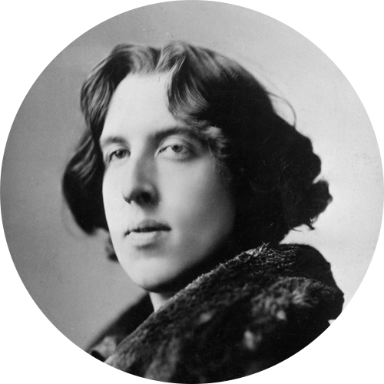
“Most people are other people. Their thoughts are someone else's opinions, their lives a mimicry, their passions a quotation.”
Oscar Wilde

Slide 16
Thank you. Questions?

